Slide 1


Drone Based Mapping and Ground Based Robotic Precision Spray System for Field Crops
Client: Andrew Nelson
Team Members: Logan Sutton & Gil Rezin
Date: December 3 2025

Slide 2
Team Member Contribution
Logan Sutton
Backend services: FastAPI endpoints, data flow integration
NodeODM/pyODM orchestration & Docker management
Path planning integration + UI-backend connectivity
Experience gained: containerized workflows, API design, stitching automation
Gil Rezin
Field map generation, NDVI processing pipeline
DBSCAN clustering and prescription analysis
Path-planning output formatting for UI integration
Client and mentor communications for requirement validation
Experience gained: data manipulation in R, unsupervised machine learning

Slide 3
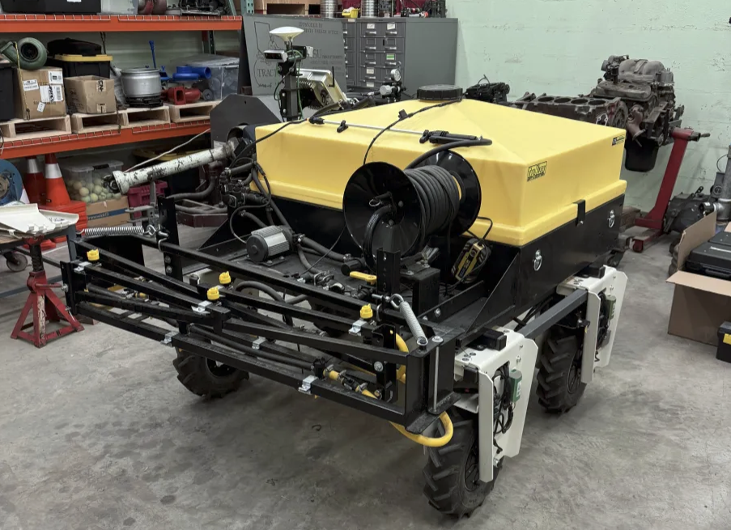
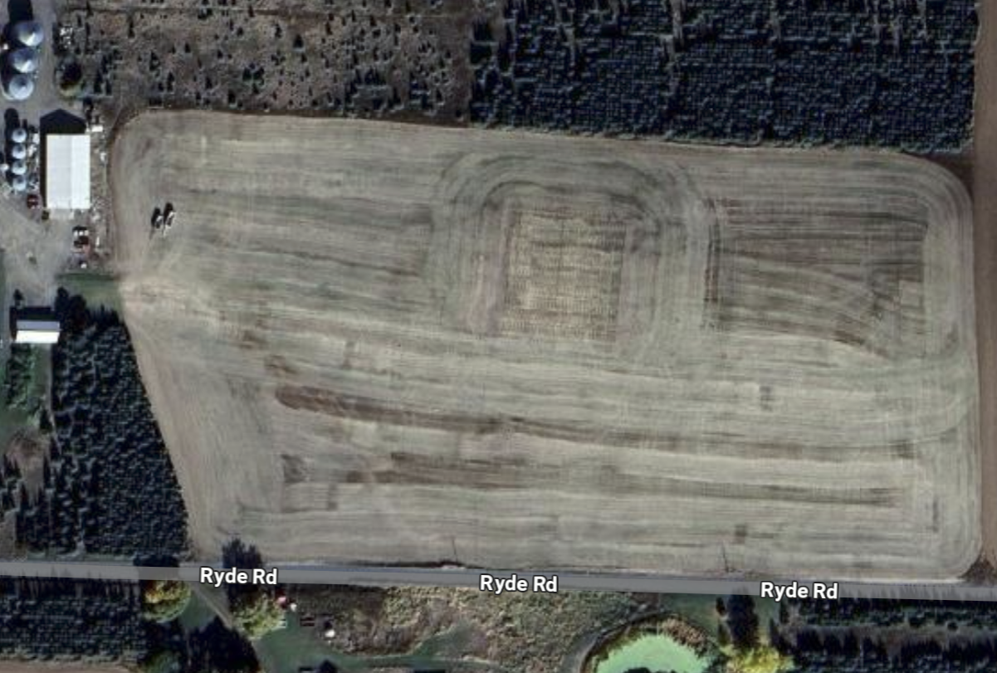
Project Overview
Automate pesticide application using drone imagery + ground robot
Full offline pipeline: image stitching → prescription → optimal path → robot execution
Goal: Reduce labor, maximize pesticide efficiency, maintain reliability for rural deployment
System designed for 20-acre wheat field in Farmington, WA

Slide 4
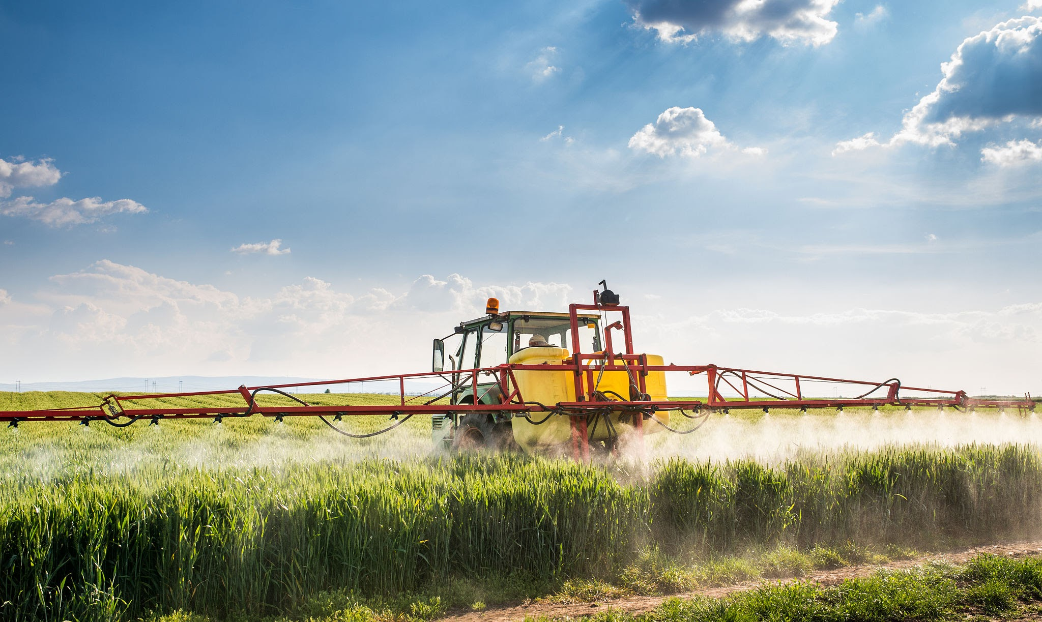
Problem Statement & Motivation
Traditional pesticide spraying costly, labor-intensive, and inconsistent
Drone sprayers: limited by wind, low precision, small tank volume
Farmers want variable-rate, data-driven, autonomous spraying workflows
Challenge: integrate imaging, ML prescription, pathfinding, and robotics into one system

Slide 5
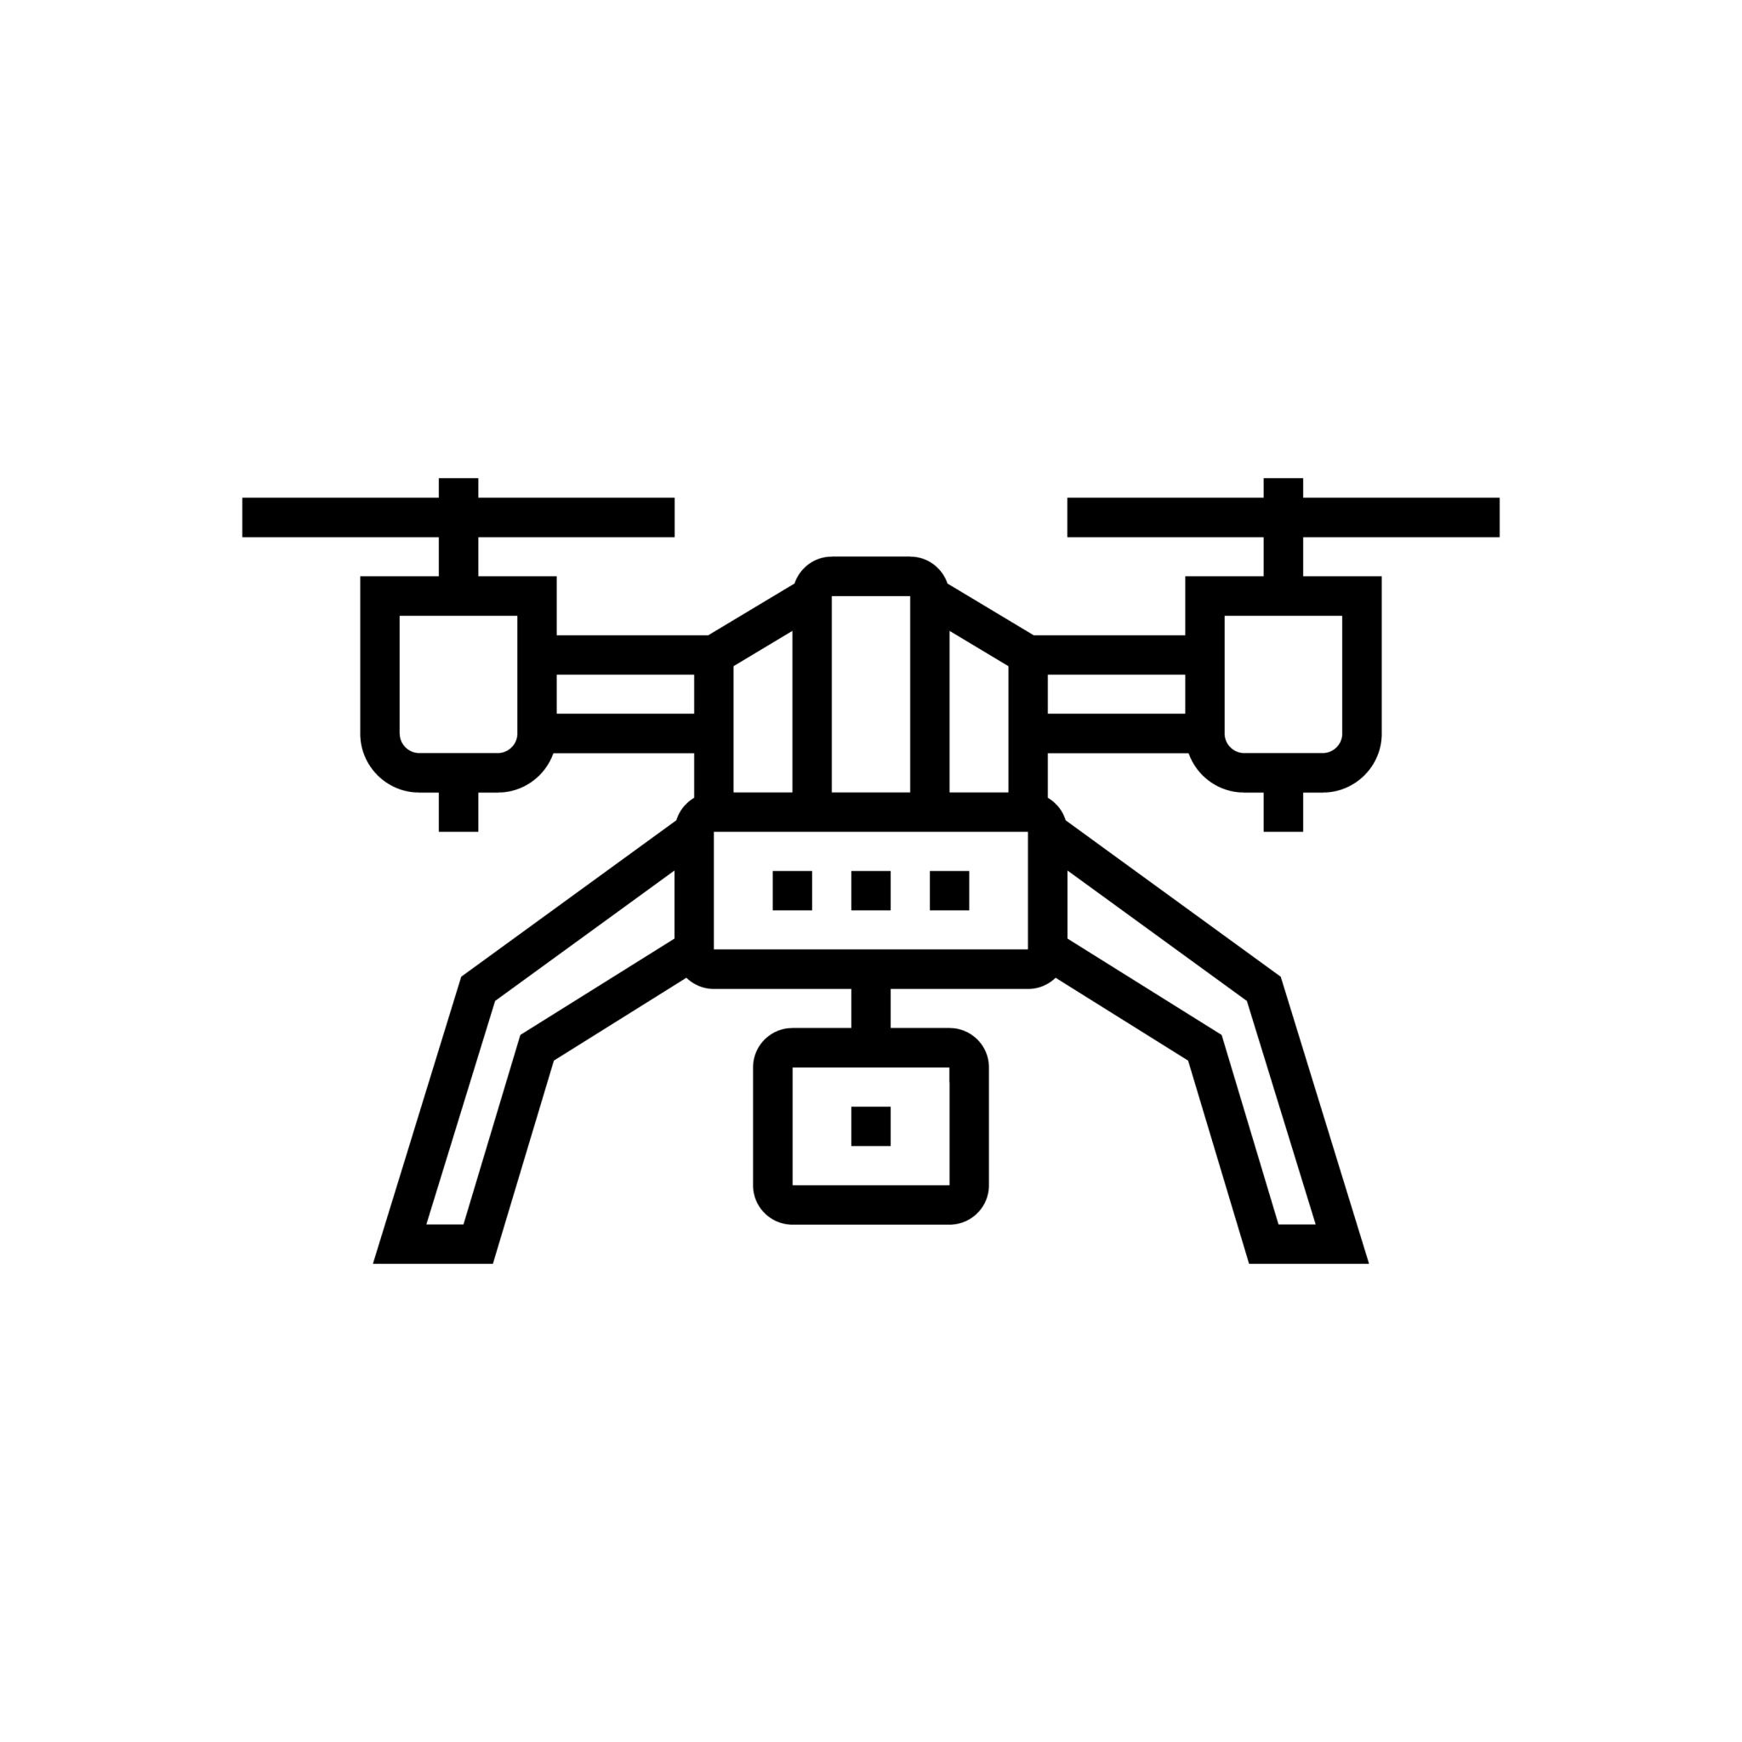

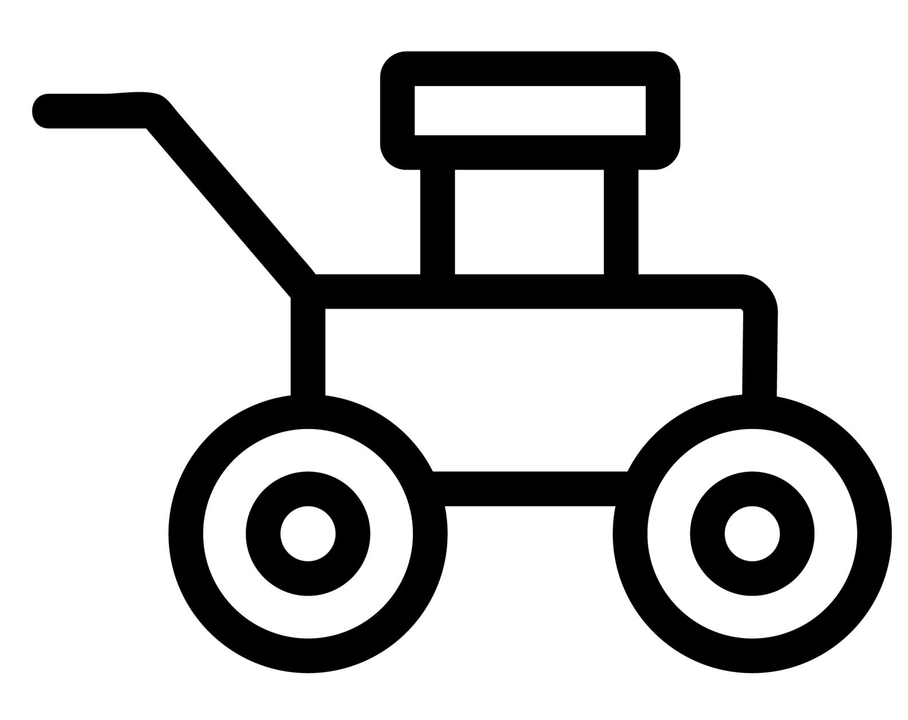
Project Scope
Included
Drone image upload and stitching (NodeODM)
NDVI vegetation analysis (FIELDimageR)
Prescription generation (ML clustering)
Path planning + robot communication
Visualization and logging modules
Not Included
Real-time cloud processing
Onboard computing on robot

Slide 6
Technologies Used
Backend: FastAPI (Python), PyODM, Dockerized NodeODM, R + FIELDimageR
Frontend: React, TypeScript, TailwindCSS
ML + Analysis: NDVI processing, DBSCAN clustering, reinforcement learning exploration
Robot: Farm-ng Amiga + custom path files + nozzle-level control
File System: Local structured directories for maps, logs, reports

Slide 7
Functional Requirements
Core Completed Functionality:
Upload & validate drone imagery (FR-01)
Stitch imagery into orthophotos (FR-02)
Generate preliminary prescription maps (FR-03)
Calculate optimal spraying path (FR-04)
Multi-file upload handling (FR-11)
Map and prescription viewing (FR-08)
Partially Implemented:
Manual prescription (FR-09)
Logging & compliance reporting (FR-14)
Visual path preview (FR-15)
Upload prescription & path to robot (FR-05, FR-06)

Slide 8

Non-functional Requirements
Performance:
Stitch 20-acre field < 5 minutes (NFR-02)
Path calculation < 2 minutes (NFR-04)
Map loading < 1 minute (NFR-03)
Usability: Responsive UI (<3 sec input delay) (NFR-07)
Architecture: Modular subsystem design (NFR-06)
Environment: 100% offline operation (NFR-05) Hardware: Designed for i7 CPU + RTX 3060 GPU (NFR-01)

Slide 9
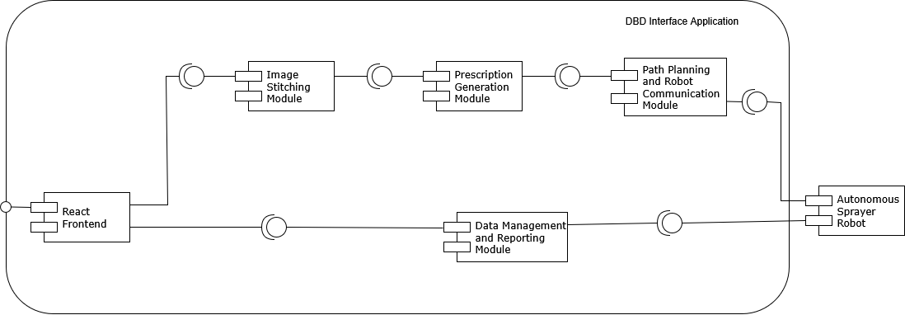
System Architecture Overview
Fully offline, modular architecture
Central FastAPI backend providing coordinated data flow
Major modules:

Slide 10
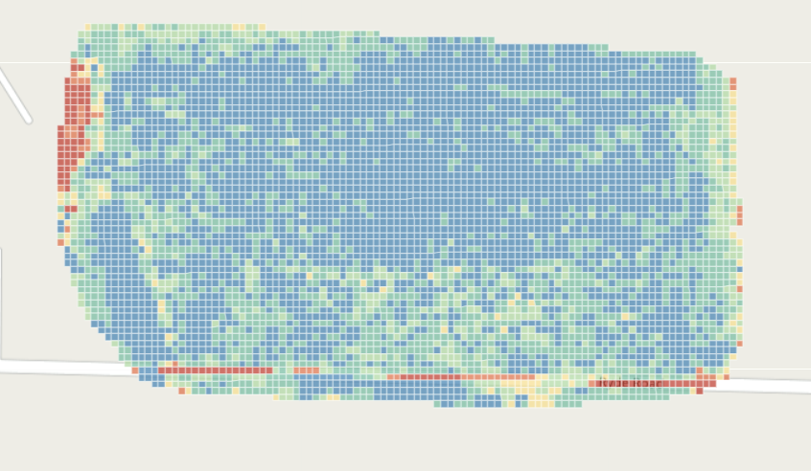
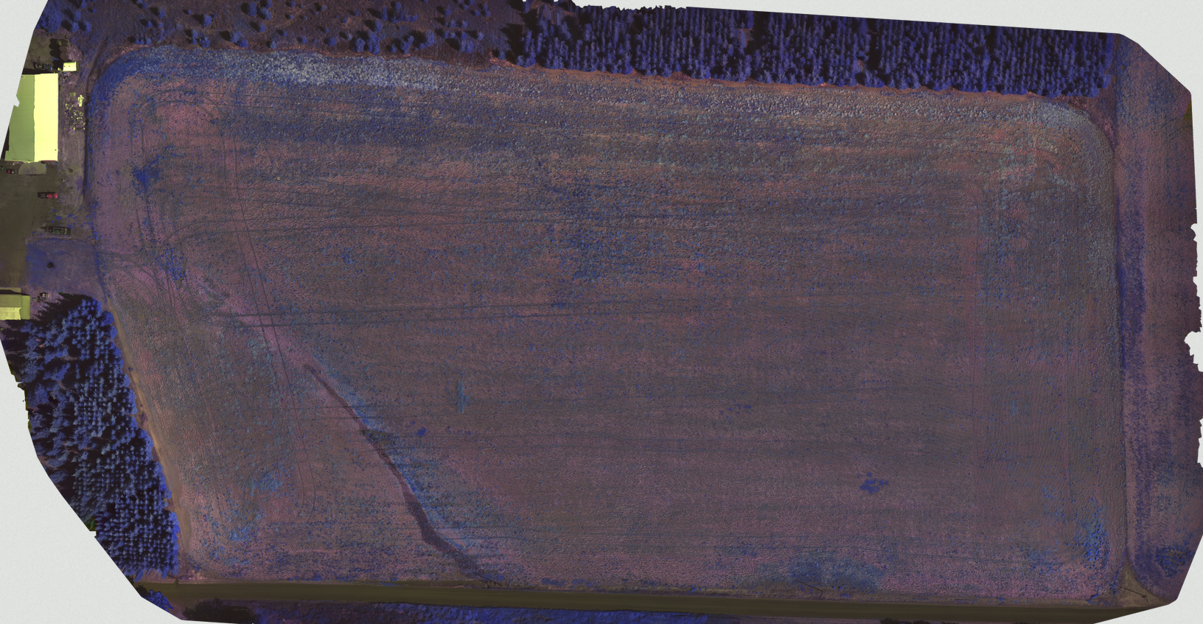

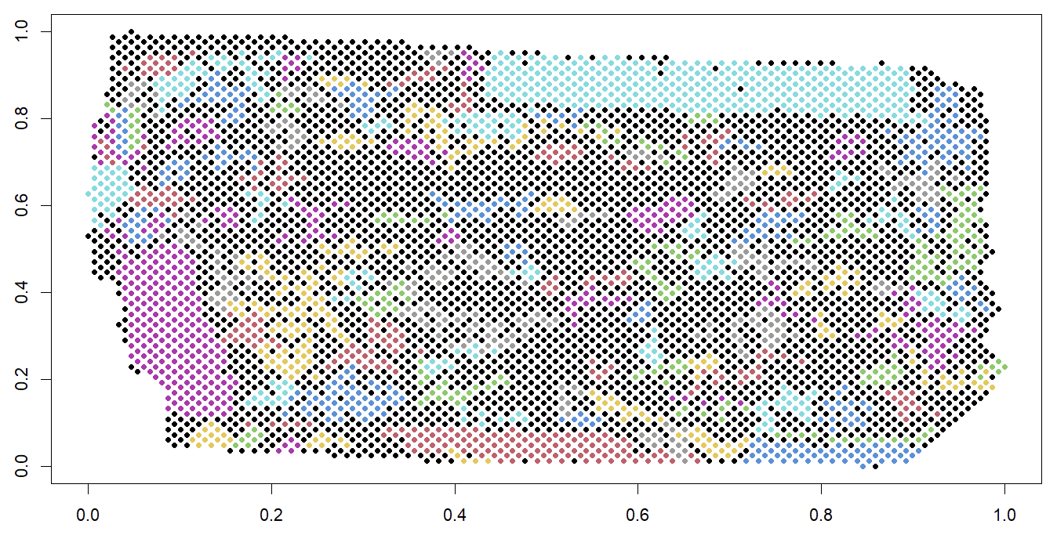
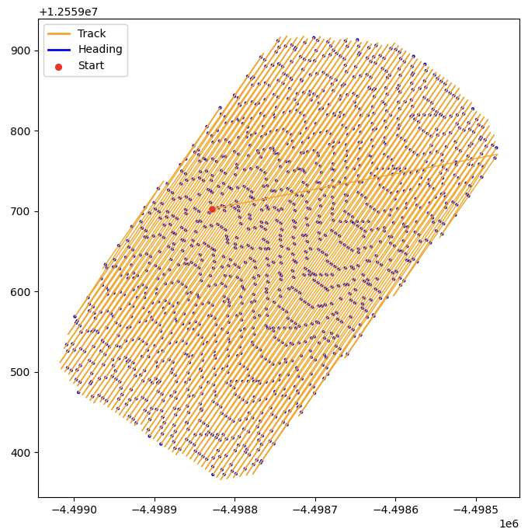


Module Interactions
Prescription Module
Stitching Module
NDVI
Validates, merges, georeference images
Path Module
Computes NDVI metric via FIELDimageR
HDBScan clustering
Generates coverage-efficient waypoints
.geojson
Notes:
Drone Imagery to Stitching Module: Validates, merges, georeferences images
Stitching to Prescription Module: Computes NDVI metric via FIELDimageR
Prescription to Path Module: Generates coverage-efficient waypoints
Path to Robot: Sends navigation + nozzle-rate instructions
Robot to Reporting Module: Sends dosage, timestamps, GPS logs
Reporting to UI: Provides summaries and performance analytics

Slide 11



Module Interactions
Prescription Module
Stitching Module
NDVI
Validates, merges, georeferences images
Path Module
Computes NDVI/NDRE metrics via FIELDimageR
HDBScan clustering
Generates coverage-efficient waypoints
.geojson
Reporting Module
Dosage applied, timestamps, GPS logging
Summary & performance analytics
Displayed to user

Slide 12
Sprint 3 Achievements
Goals
Revise field map generation and output in an acceptable format
Update frontend for better visualization of field map
Develop path planning and output a visualization
Create proper path output for Amiga
Allow user to specify prescription amounts based on NDVI clusters

Slide 13
Sprint 3 Achievements
Completed Work
Path planning prototype and visualization
NDVI calculated and clustered
UI for viewing computed field maps
Colored cluster ready for spray assignment implementation
Robot path output prototype
Input geojson
Output file of poses read by robot

Slide 14
Sprint 3 Achievements
Needs implementation
Need to integrate full pipeline of field map and pathing (currently manual)
After NodeODM ortho is processed, trigger field map generation
When geojson is output, create path
Relatively straightforward implementation
User input for spray values
High, low, no spray values assigned to clusters
Format for outputting prescription
Talk with hardware team
File streaming for image upload

Slide 15
Sprint 3 Achievements
Challenges
Two software developers on this project is proving very difficult
Large uploads to API
Fully understanding Amiga’s needs
Getting correct processing settings for NodeODM
Displaying complex data to the user

Slide 16
Sprint 3 Achievements
How we addressed challenges
Communication with client
Trial and error
Deep research past what was initially done
Studying examples and reproducing them
Whats next?
Integrate into full pipeline!
We have all the pieces, just need to connect and tweak them

Slide 17
System Demonstration Summary (Demo)
Implemented Features (≥60%):
Drone image upload interface
Local image stitching via NodeODM
Field map + NDVI processing
Basic prescription generation and clustering
Preliminary path planning algorithm
Upload of data packets to robot
UI for visualization, queue monitoring, status polling
Demonstration Outputs:
Stitched orthophoto
Prescription dosage map
Generated coverage path
Logs and basic reports

Slide 18
Testing Strategy & Methodology
Unit Testing: Image validation, pathfinding logic, UI rendering
Integration Testing: Upload → Stitch → Prescription → Path → Robot workflow
System Testing: End-to-end trial with robot hardware
Performance Testing:Timing benchmarks for stitching, path generation, loading
Standards/Constraints Verification:
IEEE 830 structure, IEEE 12207 lifecycle, WCAG 2.2 UI accessibility
Offline operation, hardware compliance
User Acceptance Testing: With Andrew Nelson and robotics challenge evaluators

Slide 19
Next Semester Plan
Timeline
weeks
Prescription ML refinement + UI polish
1 - 3
Planned Functional Work:
Refine prescription map accuracy with improved clustering + RL optimization
Integrate real-time robot telemetry feedback
Enhance obstacle avoidance and terrain handling Complete manual override and safety controls
Finalize visual path preview
Non-Functional Work:
Optimize large-dataset performance (disk I/O + GPU load)
Improve caching + incremental stitching
Strengthen reporting automation
weeks
Robot integration + safety testing
4 - 6
weeks
Stress testing + multi-acre field trials
7 - 9
week
Final documentation + challenge preparation
10

Slide 20
Responsible Use of AI
All AI generated material is 100% reviewed to ensure reliability
Used as a tool, not a replacement for labor
No sensitive data is used in LLM prompts
Overall, great tool for
Basic code generation
Refining writing
Proposing ideas
UI generation
Debugging

Slide 21
Conclusion
Successfully built an end-to-end prototype integrating drone imagery, ML prescription, and robot path planning (WIP)
Achieved key goals: offline operation, modular design, and reliable image-to-path workflow
Lessons learned: data size issues, robot communication constraints, and impact of field variability
Strong foundation for second-semester development and Farm Robotics Challenge deployment

Slide 22
Thank you!
We’re excited to continue developing this system next semester!

Slide 23
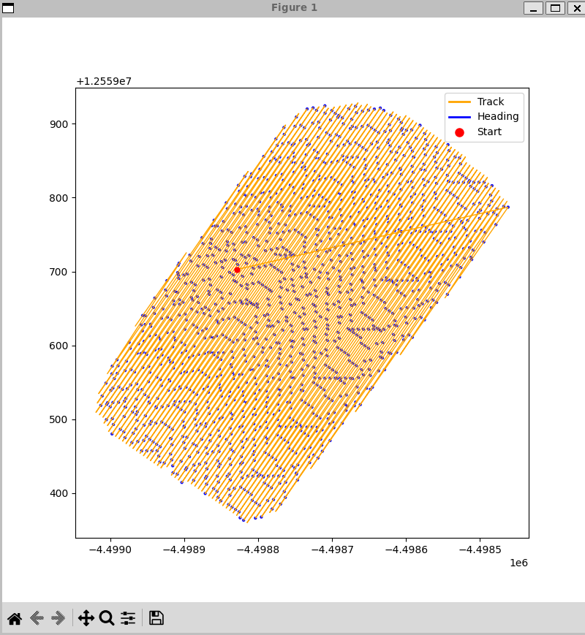
Path Visualization WIP
Start point (red) can be set anywhere
Needs improvements to turning
Need to account for field headlands
Output format read by Amiga
Goal is to overlay with field map / image

Slide 24
Path Output
Show example on VS code

